Slide 1
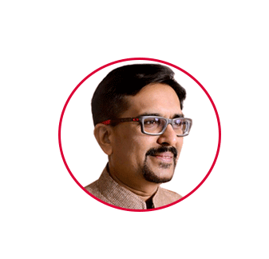

Founder | Instigator
RJ Sir
(Mr. Rajesh Bhavsar)
You
don’t fail,
give up
www.rajeshbhavsar.com | therjsir@gmail.com | +91 77790 10101| +91 90816 28628

Slide 2







PLACEMENT
www.irojgar.com
+91 77790 10101
COACHING
www.racevarsity.com+91 76009 09090
IMMIGRATION
www.goforen.com
+91 76000 14090
CO-WORKING
www.careeriaa.com+91 85111 10221
Since 2006
CAREER OPPORTUNITIES
FOR YOUTH
RJ sir
www.rajeshbhavsar.com | therjsir@gmail.com | +91 77790 10101| +91 90816 28628

Slide 3



I Need Staff
Being Knowledgeable Employer :
રોજગારદાતા તરીકેની આપણી ક્ષમતા....
Coaching
Placement
Immigration
Co-Working
JOBS
FOR
JANTA
www.irojgar.com | irojgarmail@gmail.com | +91 77790 10101| +91 90816 28628

Slide 4

SEQUENCE
Coaching
Placement
Immigration
Co-Working
About RJ sir and creation of iROJGAR
Vision, Mission & Values of iROJGAR
Organizational Tree
Employer’s Perception of Job Seeker
Process flow chart for JP to hire a candidate
Level of jobs and Salary offered
Success stories (of hiring Candidates)
Benefits to registered Job Providers
Industries we focus on for job Providers
Services offered by iROJGAR (to Job Providers)
Our commitment towards job Providers.
Contact us
JOBS
FOR
JANTA
www.irojgar.com | irojgarmail@gmail.com | +91 77790 10101| +91 90816 28628

Slide 5

ABOUT US
Coaching
Placement
Immigration
Co-Working
Founded by Mr. Rajesh Bhavsar (a technocrat and mentor) in 2015. Currently having a workforce of more than 20 people.
Parent company – RACE - has roots in academics and coaching for the last 18 years.
Headquartered in Surat, South Gujarat. Operating majorly for South Gujarat.
Currently 500+ clientele. Regularly placing more than 50+ candidates in private jobs every months.
JOBS
FOR
JANTA
www.irojgar.com | irojgarmail@gmail.com | +91 77790 10101| +91 90816 28628

Slide 6


DRIVING VISION OF iROJGAR
Coaching
Placement
Immigration
Co-Working
To promote sustainable economic growth by coordinating workforce for proper job placement and thereby enhancing social stability and quality of life of families. It means
JOBS
FOR
JANTA
better work,
better career,
better life.
www.irojgar.com | irojgarmail@gmail.com | +91 77790 10101| +91 90816 28628

Slide 7

MISSION: JOBS FOR JANTA
Inspired by Mission statement of iROJGAR
Right job to each one as well as right employee to each establishment.
Innovative and economical solutions with use of technology to meet job market requirements.
To enhance competitiveness and harmony of job seekers by providing vocational guidance and skill development training.
To partner/collaborate/sign MoU’s with market majors (companies) to ensure large presence for (Indian) job seekers.
To create and maintain the database related to skill requirements of a dynamic Labour market.
Coaching
Placement
Immigration
Co-Working
JOBS
FOR
JANTA
www.irojgar.com | irojgarmail@gmail.com | +91 77790 10101| +91 90816 28628

Slide 8

DIE HARD VALUES OF iROJGAR
Coaching
Placement
Immigration
Co-Working
Empathy
Going the extra mile
Honesty, Integrity and Confidentiality
To remain consistantly consistant
JOBS
FOR
JANTA
www.irojgar.com | irojgarmail@gmail.com | +91 77790 10101| +91 90816 28628

Slide 9



ORGANIZATIONAL CHART
Coaching
Placement
Immigration
Co-Working
Founder
RJ Sir
JOBS
FOR
JANTA
Head of
Department
Web Based Solutions
Advisor on Board
Marketing/Promotion
Front Office
Back Office
MoU’s/Associations
With Other Placement Companies
www.irojgar.com | irojgarmail@gmail.com | +91 77790 10101| +91 90816 28628

Slide 10
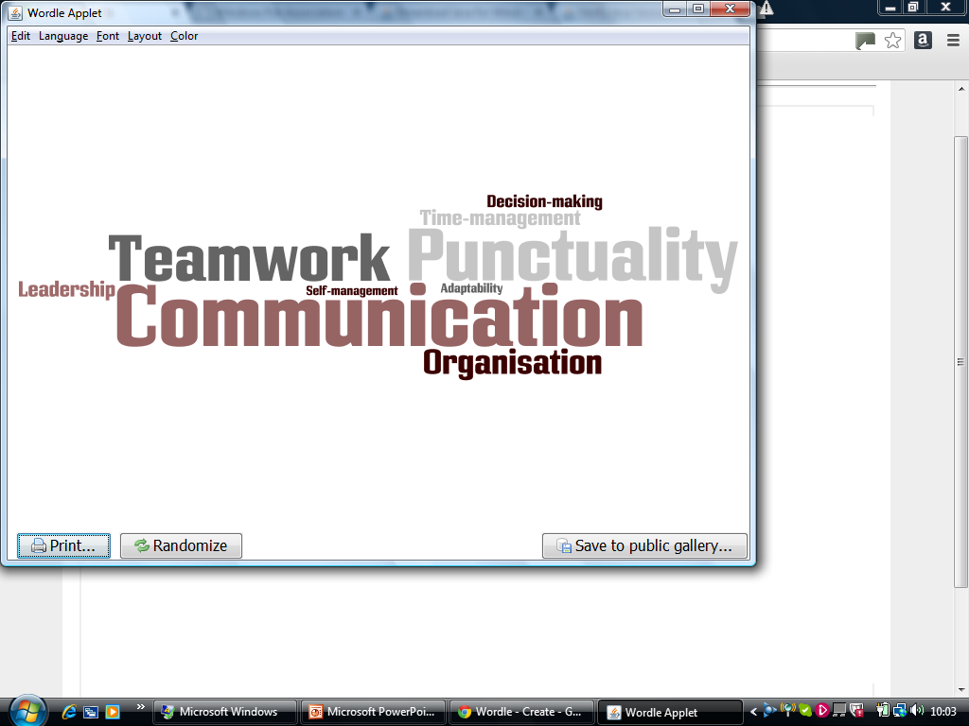
Employer’s Perception on Employability of a Candidate
Coaching
Placement
Immigration
Co-Working
“How Speedily he will understand his duty”.
“Is it Possible to retain a candidate for at least 5 years after an appointment”.
JOBS
FOR
JANTA
“Suitability of a Candidate for a specific Job”.
www.irojgar.com | irojgarmail@gmail.com | +91 77790 10101| +91 90816 28628

Slide 11

Process Flow Chart for Getting a Candidate
Coaching
Placement
Immigration
Co-Working
Job Provider
Job Seeker
Directly Connected After Match
JOBS
FOR
JANTA
Register
Post Jobs
Ask for Details on Match
Register
Upload Resume
Apply For Matching Jobs
Get detail after request
Get detail through SMS/ E-mail/ Voice Call
www.irojgar.com | irojgarmail@gmail.com | +91 77790 10101| +91 90816 28628

Slide 12

Process to be followed by a J P for getting a Candidate-1
Inquiry – Call at office/executive- Registration
Job description of a Particular post and some special requirements of a post.
Searching and Screening of Candidates by iROJGAR
Resume Forwarded to Job Provider after matching a job description
(I) Interview by iROJGAR
(II) Interview to be conducted at venue given by Job Provider
Coaching
Placement
Immigration
Co-Working
JOBS
FOR
JANTA
www.irojgar.com | irojgarmail@gmail.com | +91 77790 10101| +91 90816 28628

Slide 13
Process to be followed by a J P for getting a Candidate-2
6. Outcome of an interview – Not selected/kept on hold/ 2nd round/ Selected by Job Provider
7. Candidate decide to join and/or retain a job within given time after confirmed selection.
8. JP also decides to retain (or not to retain) the candidate within 7 days, after his joining.
9. LIABILITY OF iROJGAR ENDS, but RESPONSIBILITY STILL EXISTS as per Agreement.
10. iROJGAR makes monthly / quarterly / yearly follow up and feedback of both sides to understand the JOB MARKET of SURAT.
Coaching
Placement
Immigration
Co-Working
JOBS
FOR
JANTA
www.irojgar.com | irojgarmail@gmail.com | +91 77790 10101| +91 90816 28628

Slide 14

DOCUMENTS (TO BE Checked by JP) - 1
Coaching
Placement
Immigration
Co-Working
Proof of Birth/Age – School Leaving Certificate, 10th Passing Certificate, Birth date Certificate from Municipal Council, etc.
Qualification – 10th passing, 12th passing, Graduation (all mark sheets), Degree Certificate, Higher Education Certificates, TRANSCRIPT OF SYLLABUS
Skills/ Vocational Development – Typing, Computer Courses, English Proficiency, Any other specific job related skills
Id Proof – Driving Licence, PAN card, Pass port, AADHAR card, Election voter card, Photograph, etc.
JOBS
FOR
JANTA
www.irojgar.com | irojgarmail@gmail.com | +91 77790 10101| +91 90816 28628

Slide 15
DOCUMENTS (TO BE Checked by JP) - 2
Coaching
Placement
Immigration
Co-Working
E. Proof of previous job – Appointment letter, photograph taken on duty, id card of company, etc.
F. Experience Letter – It should thoroughly narrate your duties and responsibilities, designation, signed by authority.
Salary – Salary slip, Bank passbook transfer entry, Salary certificate, etc.
Practical test should be conducted, if needed.
JOBS
FOR
JANTA
www.irojgar.com | irojgarmail@gmail.com | +91 77790 10101| +91 90816 28628

Slide 16

Checking of Personal presentation of a Candidate- 1
For MEN:
Coaching
Placement
Immigration
Co-Working
Personal grooming-Body cleanliness (Clean shave, properly combed hair, Cut nail, hair on body, tattoo, face grooming, etc.)
Clothes (suitable to job you are applying for, light pastel colour shirt and dark trousers, Best available formal in your wardrobe, pen pocket shall be empty)
Accessories (belt, shoes, ear rings, watch, hand rings, necklace, etc.)
Portfolio (Colour of folder, file of certificates, arrangements, condition of papers in portfolio.)
JOBS
FOR
JANTA
IMPORTANT : Candidate must have switched off his mobile and kept it in bag.
www.irojgar.com | irojgarmail@gmail.com | +91 77790 10101| +91 90816 28628

Slide 17

Personal presentation of a job seeker - 2
For WOMEN:
Coaching
Placement
Immigration
Co-Working
Personal grooming Body cleanliness (Clear skin, properly combed hair, eye brow, Nail polish, hair on body, tattoo, face grooming, etc.)
Clothes (suitable to job you are applying for, a decent Salwar-Kameez which has decent colors. Avoid wearing flashy outfits, best available formal in your wardrobe,)
Accessories (shoes, ear rings, watch, hand rings, nose rings, necklace, etc.)
Portfolio (Colour of folder, file of certificates, arrangements, condition of papers in portfolio.)
JOBS
FOR
JANTA
IMPORTANT : Candidate must have switched off his mobile and kept it in bag.
www.irojgar.com | irojgarmail@gmail.com | +91 77790 10101| +91 90816 28628

Slide 18

What does interview mean to an Employer? - 1
An interview for an Employer is an opportunity for him to have an interaction with the prospective employee in order to check his attitude towards the job in contention face to face.
The Employer is more interested in concluding whether the job aspirant in question is the perfect choice for the vacancy he has in his organization.
The Employer is more interested in minimizing his attrition rate.
The Employer is interested in knowing whether or not you can serve him anywhere/any time as and when required.
The Employer wants to check how well a job aspirant is oriented towards the job he/she has applied for.
Coaching
Placement
Immigration
Co-Working
JOBS
FOR
JANTA
www.irojgar.com | irojgarmail@gmail.com | +91 77790 10101| +91 85111 10221

Slide 19
What does interview mean to an Employer? - 2
Special emphasis to market awareness is given so that he may not be cheated in any manner whatsoever by fraudulent approaches.
How you may contribute through your studies/ knowledge/ experience to business development of an employer.
Thus, an employer reviews a candidates experience, abilities and is seeking answers for the following Questions:
Can you do the job? (skills, qualifications and abilities)
Will you do the job? (interest, attitude and motivation)
How will you fit into the organization? (personality)
Coaching
Placement
Immigration
Co-Working
JOBS
FOR
JANTA
www.irojgar.com | irojgarmail@gmail.com | +91 77790 10101| +91 90816 28628

Slide 20
What does interview mean to a candidate ?
Coaching
Placement
Immigration
Co-Working
An interview is an opportunity for the job seeker to “Sell” his/her abilities. It is also an opportunity to ask questions and learn more about the position and career offered by a company/ organization.
An Interview call should make a job seeker more self-confident and should not make him nervous.
An interview call means that the job aspirant’s aptitude is good enough, but what about his/her attitude?
An interview call is the opportunity at hand waiting to be converted. He should make the interview look like an INTERACTION and not a boring conversation in which the recruiter is not interested.
Your Job interview is your gateway towards a bright career. Whatever the opportunity is, accept it gracefully with optimism.
JOBS
FOR
JANTA
www.irojgar.com | irojgarmail@gmail.com | +91 77790 10101| +91 90816 28628

Slide 21

Most frequent interview questions - 1
Coaching
Placement
Immigration
Co-Working
Tell me about yourself.
What do you want to be in your life?
Do you have any actual work experience?
How would you describe your ideal job?
Why did you choose this job/career?
Where do you live? Since how long you have been living at this address?
Are you ready to sign a bond for one year?
What will you do, if you find an offer in your field?
What will you do, if you find a better offer in your field?
What goals do you have in your career?
JOBS
FOR
JANTA
www.irojgar.com | irojgarmail@gmail.com | +91 77790 10101| +91 90816 28628

Slide 22

Most frequent interview questions - 2
11) How do you plan to achieve these goals?
12) How do you evaluate success?
13) What will you do to be successful in this career?
14) What accomplishments have given you the most satisfaction in your life?
15) Are you a team player? What motivates you?
16) Why should I hire you? Are you a target-oriented person?
Tell me about some of your recent targets and what you did to achieve them. What are your short-term goals?
18) Where do you want to be ten years from now?
19) Have you ever had a conflict with a boss or colleague? How do you handle it? How did you resolve it?
20) Do you handle/withstand pressure well?
Coaching
Placement
Immigration
Co-Working
JOBS
FOR
JANTA
www.irojgar.com | irojgarmail@gmail.com | +91 77790 10101| +91 90816 28628

Slide 23

Most frequent interview questions - 3
Coaching
Placement
Immigration
Co-Working
21) What is your greatest strength/positive point?
22) What is your greatest weakness/negative point?
23) If I were to ask one of your professors/previous employer to describe you, what would he say?
24) How has your education prepared you for your career?
25) Who were your favourite professors? Why?
26) Do you have any plans for further education/marriage?
27) How much training do you think you'll need to become a productive employee?
28) What qualities do you feel a successful employer should have?
29) Why do you want to work in the _____ industry?
30) What do you know about our company? Why are you interested in our company? Do you have any location preferences? How familiar are you with the community that we're located in? Will you relocate?
JOBS
FOR
JANTA
www.irojgar.com | irojgarmail@gmail.com | +91 77790 10101| +91 90816 28628

Slide 24

Satisfied Clients : Only Indicative List - 1
Coaching
Placement
Immigration
Co-Working
Name of Company | Name of Contact Person | Job Post | Location of Post | Remark
Arihant Diamond Institute | Mr. Harsh Raval | Receptionist | Katargam
Ashish Technocrat Pvt. Ltd. | Mr. Brijal Mody | Accountant | Adajan road
Ashok Textiles | Mr. Ravi | M/C Fitter | Sachin gidc
B. L. Kakadiya & Co. | Mr. Bhavesh Kakadiya | Tax Consutant | varachha road
Dron Study Private Limited | Mr. B. L. Agarwala | BDM (Business Development Manager) | Ring road
English Pathshala | Mr. Ashok Patel | Teacher | varachha road
Gujarat Matador House | Mr.tarun | Sales / Marketing | Lal darwaja
Hashrail Info Pvt.ltd | Mr.dharam Joshi | PHP developer | Parvat Patiya
Jains Trip Holiday | Mr.pankaj Jain | Front Desk Executive | Vesu
Leomine Organics Pvt. Ltd. | Mr. Darshan Thakkar | Accountant | Udhana
Maheshkumar Mittal & Co. | Abhishek Mittal | Typist cum IT Assistant | Ring road
JOBS
FOR
JANTA
www.irojgar.com | irojgarmail@gmail.com | +91 77790 10101| +91 90816 28628

Slide 25
Success Stories : Only Indicative List is Mentioned -1
Name of Company | Name of Contact Person | Job Post | Location of Post | Remark
Novus Knitting Company | Mr. Dhruv Shah | Accountant | Ring road
Oasis Interior | Anil Jadvani | Accountant | Udhana magdalla road
One Stop Solution Wealth Advisory | Mr.dipen Shah | Back Office Executive | Vyara
Prabhudas Lilladhar Pvt. Ltd. | Mr. Vijay Kadam | E-Commerce Executive | ghod Dod Road
Prenea Sarees | Mr. Hiren | E-Commerce Executive | Kadodra
R.s. Expo Fabs (p) Ltd. | Mr. Avdhesh | Dispatch Person | Ring road
Rachna Academy Of Career Education | Mr. Rahul Parekh | PHP Developer ( IT Support) | Nanpura
Ramoliya Bhanderi & Co | Sujit Patel | Accountant | varachha road
Rj Kitchen | Jayesh Thakkar | Marketing Executive | Ring road
Rowan Décor | Siddharth Kapadia | Inhouse sale | Adajan road
Shaadi Vedio Film | Mr. Nirav Patel | Front Desk Executive | varachha road
Coaching
Placement
Immigration
Co-Working
JOBS
FOR
JANTA
www.irojgar.com | irojgarmail@gmail.com | +91 77790 10101| +91 90816 28628

Slide 26

Level of Job, Salary Offered
Level | General Business (B.A.,B.Com.,B.Sc., etc.) |  | Special Business (Professional Skill)
 | Experience in Year | Salary Per Annum | Experience in Year | Salary Per Annum
Entry Level | 00 – 02 | Up to 125 k | 00 – 02 | Up to 175 k
Intermediate Level | 02 – 05 | Up to 200 k | 02 – 05 | Up to 325 k
Middle Management | 05 – 10 | Up to 275 k | 05 – 10 | Up to 550 k
Upper Management | 10 – 15 | Up to 350 k | 10 – 15 | Up to 1000 k
Executive (CXo’s) | > 15 | > 450 k | > 15 | > 1250 k
Coaching
Placement
Immigration
Co-Working
JOBS
FOR
JANTA
www.irojgar.com | irojgarmail@gmail.com | +91 77790 10101| +91 90816 28628

Slide 27

Recent success stories:
Every month 15+ New Providers are joining
Every month 50+ selection …..
Coaching
Placement
Immigration
Co-Working
JOBS
FOR
JANTA
www.irojgar.com | irojgarmail@gmail.com | +91 77790 10101| +91 90816 28628

Slide 28

Services to Job Providers after registration activated
Coaching
Placement
Immigration
Co-Working
Price competitive and quality services
Instead of finding/searching a job on your own, you have passed the headache (task) to Us.
Vast database of open vacancies to choose from i.e. more options
Strong knowledge of placement market and stronger professional presence
Leverage to your career through our network
Quick, reliable, most suitable and constant deployment at desired placement
JOBS
FOR
JANTA
www.irojgar.com | irojgarmail@gmail.com | +91 77790 10101| +91 90816 28628

Slide 29
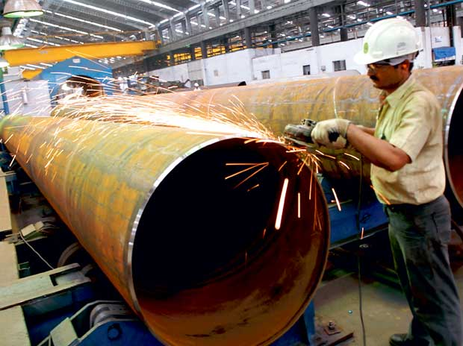


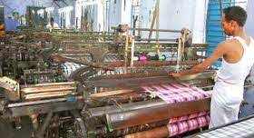
Industries/ Service sector/ professionals, we focus on
Textile
Diamond
Construction
Power sector
Manufacturing
Retail / FMCG
Hospitality (Hotels/ restaurants)
IT / ITES
Insurance
Transportation / logistics
Banking
Stock market
Medical
And many more…….
Coaching
Placement
Immigration
Co-Working
JOBS
FOR
JANTA
www.irojgar.com | irojgarmail@gmail.com | +91 77790 10101| +91 90816 28628

Slide 30

Other services for Job Providers:
Coaching
Placement
Immigration
Co-Working
Registration and Placement of Job Seekers.
SMS /Whatsapp Alerts for Candidate
Staff training.
Business development ideas.
HR management.
Job Fair
Conducting interviews (on behalf of JP)
JOBS
FOR
JANTA
www.irojgar.com | irojgarmail@gmail.com | +91 77790 10101| +91 90816 28628

Slide 31

Our Commitment:
Coaching
Placement
Immigration
Co-Working
Interview Call for
Any Recruitment in just days. ….!!!!
15
JOBS
FOR
JANTA
www.irojgar.com | irojgarmail@gmail.com | +91 77790 10101| +91 90816 28628

Slide 32

Coaching
Placement
Immigration
Co-Working
JOBS
FOR
JANTA
www.irojgar.com | irojgarmail@gmail.com | +91 77790 10101| +91 90816 28628

Slide 33



Coaching
Placement
Immigration
Co-Working
iROJGAR
JOBS
FOR
JANTA
701/702, 7th floor, Joyos Hubtown, Adajan Bus Port, Surat-395009
Mobile No. : +91 77790 10101
WhatsApp No.: +91 90816 28628
Web : www.irojgar.com
Follow us:
www.irojgar.com | irojgarmail@gmail.com | +91 77790 10101| +91 90816 28628

Slide 34


Coaching
Placement
Immigration
Co-Working
JOBS
FOR
JANTA
www.irojgar.com | irojgarmail@gmail.com | +91 77790 10101| +91 90816 28628

Slide 35


Coaching
Placement
Immigration
Co-Working
JOBS
FOR
JANTA
Thank You
www.irojgar.com | irojgarmail@gmail.com | +91 77790 10101| +91 90816 28628

